Slide 1

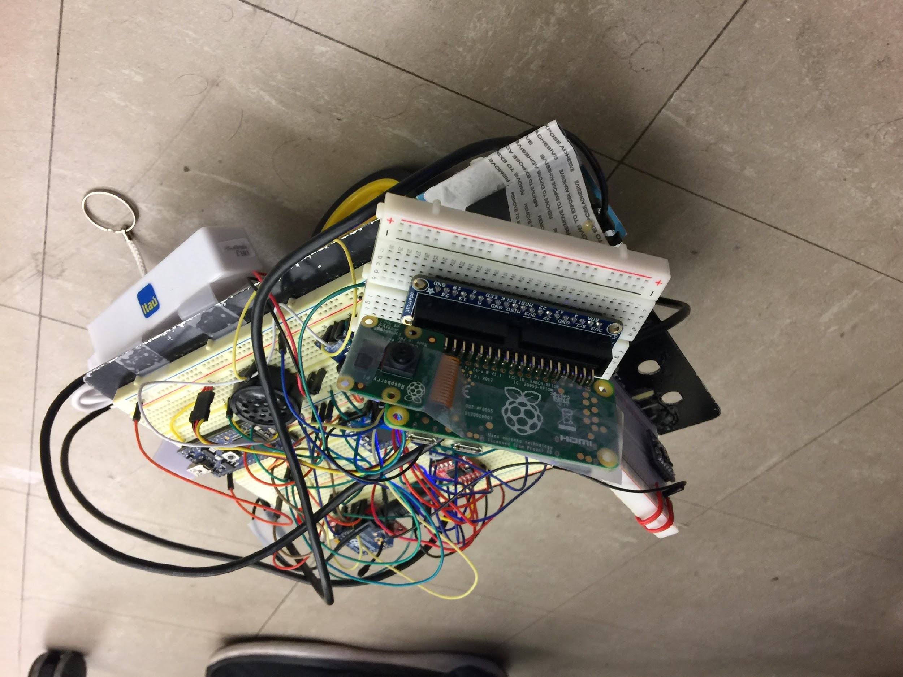
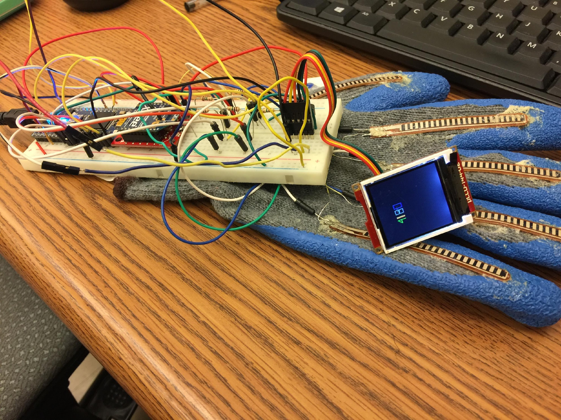
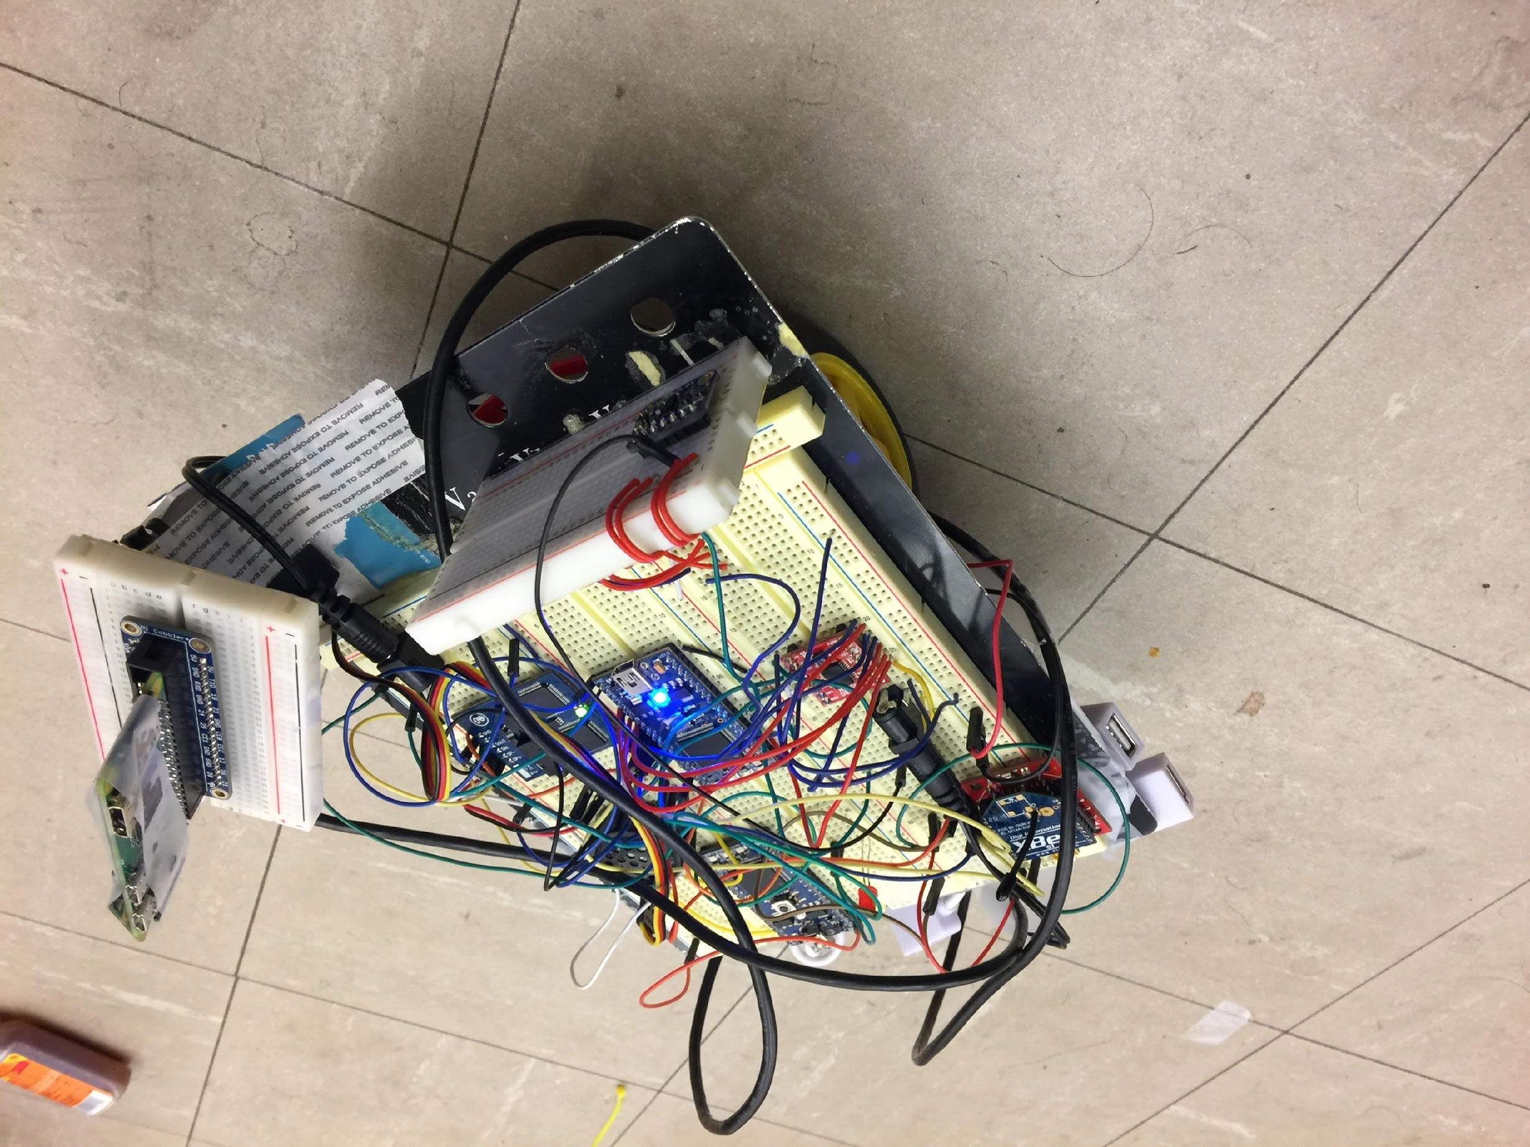
ECE 4180 FINAL PROJECT GLOVE-BOT
Animesh Patel
Kevin Chang
Zheyuan Xu

Slide 2
Introduction
Glove functionalities:
Motor Control: Glove contains flex sensors and Xbee module to wirelessly connect to the cart, Through which user controls Right, Left. Backward, Forward, and Stop conditions of cart using first, second, third, fourth finger and thumb respectively.
Display: Additionally, glove contains uLCD through which it constantly detects the temperature and produces bar graphs on the uLCD.
Cart Functionalities:
Cart constantly takes pictures in left, center, and right directions and stores on raspberry pi. It is controlled by glove, but also constantly checks for the obstacles bypassing user preference. Upon detecting an object within 20 cm, it checks in the left or right directions (randomly) until it finds a suitable path to proceed.

Slide 3
Parts used for the cart Parts used for the Glove
2 mbed NXP LPC 1768 Micro-controllers 1 Mbed NXP LPC 1768
1 Xbee 1 mw wire antenna -series 1 1 Xbee 1mw Wire Antenna- series 1
1 Text-to-Speech Module - Emic 2 1 temperature sensor
1 Dual H-Bridge Motor Driver 5 Flex sensor
1 Lidar VL530L0X ToF Distance Sensor 1 smart color uLCD
1 Speaker
1 Raspberry Pi Zero
1 Raspberry Pi Camera Module V2
2 Dc Motors
1 RC Servo
1 external Battery pack
2 wheels

Slide 4
Challenges Faced:
Xbee wire antenna required careful attention for transferring wireless signals from the glove to the cart’s Xbee module. Identifying sensor data from flex sensors.
Power-management and placement of camera: With cart functionalities requiring additional power, it was challenging to come up with the placement of additional battery packs.
Raspberry pi camera setup on servo part also had gone through many unsuccessful trials.
Camera timings with servo: it required multiple trial and errors for setting up the timings for raspberry pi camera in accordance with the servo movements.

Slide 5
Demo
https://www.youtube.com/watch?v=VPO-q2qLW0E&feature=youtu.be

Slide 6
Potential Future Development
Creating VR experience: addition of vr would allow the user to visualize cart movements in a gaming-like environment in addition to sound effects involving cart screeching, accelerating, turning, etc.
Development on smart lighting: Turns on the lights depending on the certain threshold of RGB values from images and turns off for bright enough environment.
Ml for speed-management: creating machine learning mathematical models in real time through image processing to determine the optimal speed for certain tasks (e.g. Going downhill on terrain through speed control to save the cart from flipping).
3D-case for organizing better.
Notes:
Going downhill on terrain: means that at what power the cart can sustain its balance while finishing the distance in shortest amount of time (what’s the max power it can operate on without tripping up).
Snow example: so if the cart detects multiple freeways but one is shorter and the other is longer, the longer route may consume low power depending on the path surroundings and inclinations

